Slide 1
DEAD LOCKS
Lecturer: Suman Thapaliya

Slide 2
What is Deadlock
In an operating system, a deadlock is a situation which occurs when a process or thread enters a waiting state because a resource requested is being held by another waiting process, which in turn is waiting for another resource held by another waiting process. If a process is unable to change its state indefinitely because the resources requested by it are being used by another waiting process, then the system is said to be in a deadlock.
Deadlock is a common problem in multiprocessing systems, parallel computing and distributed systems, where software and hardware locks are used to handle shared resources and implement process synchronization.
In telecommunication systems, deadlocks occur mainly due to lost or corrupt signals instead of resource contention.

Slide 3
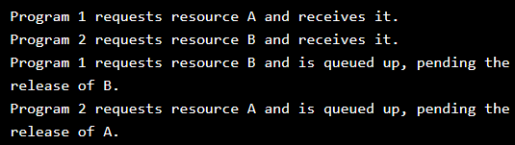
Deadlock
A deadlock is a situation in which two computer programs sharing the same resource are effectively preventing each other from accessing the resource, resulting in both programs ceasing to function.
The earliest computer operating systems ran only one program at a time. All of the resources of the system were available to this one program. Later, operating systems ran multiple programs at once, interleaving them. Programs were required to specify in advance what resources they needed so that they could avoid conflicts with other programs running at the same time. Eventually some operating systems offered dynamic allocation of resources. Programs could request further allocations of resources after they had begun running. This led to the problem of the deadlock. Here is the simplest example:

Slide 4
Now neither program can proceed until the other program releases a resource. The operating system cannot know what action to take. At this point the only alternative is to abort (stop) one of the programs. Learning to deal with deadlocks had a major impact on the development of operating systems and the structure of databases. Data was structured and the order of requests was constrained in order to avoid creating deadlocks.
In general, four strategies are used for dealing with deadlocks.
Just ignore the problem altogether. Maybe if you ignore it, it will ignore you.
Detection and recovery. Let deadlocks occur, detect them, and take action.
Dynamic avoidance by careful resource allocation.
Prevention, by structurally negating one of the four conditions necessary to cause a deadlock.

Slide 5
A simple computer-based example is as follows. Suppose a computer has three CD drives and three processes. Each of the three processes holds one of the drives. If each process now requests another drive, the three processes will be in a deadlock. Each process will be waiting for the "CD drive released" event, which can be only caused by one of the other waiting processes. Thus, it results in a circular chain.
Moving onto the source code level, a deadlock can occur even in the case of a single thread and one resource (protected by a mutex). Assume there is a function func1() which does some work on the resource, locking the mutex at the beginning and releasing it after it's done. Next, somebody creates a different function func2() following that pattern on the same resource (lock, do work, release) but decides to include a call to func1() to delegate a part of the job. What will happen is the mutex will be locked once when entering func2() and then again at the call to func1(), resulting in a deadlock if the mutex is not reentrant (i.e. the plain "fast mutex" variety).

Slide 6
Deadlock Condition
A dead lockers situation can arise if all of the following conditions hold simultaneously in a system:
Mutual Exclusion: At least one resource must be held in a non-shareable mode. Only one process can use the resource at any given instant of time.
Hold and Wait or Resource Holding: A process is currently holding at least one resource and requesting additional resources which are being held by other processes.
No Preemption: a resource can be released only voluntarily by the process holding it.
Circular Wait: A process must be waiting for a resource which is being held by another process, which in turn is waiting for the first process to release the resource. In general, there is a set of waiting processes, P = {P₁, P₂, ..., P_{N}}, such that P₁ is waiting for a resource held by P₂, P₂ is waiting for a resource held by P₃ and so on until P_{N} is waiting for a resource held by P₁.
These four conditions are known as the Coffman conditions from their first description in a 1971 article by Edward G. Coffman, Jr. Un fulfillment of any of these conditions is enough to preclude a deadlock from occurring.

Slide 7
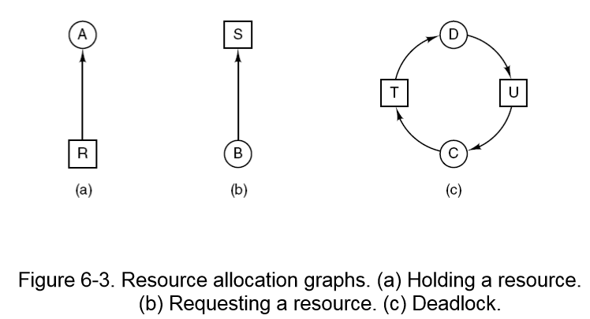
Deadlock Modeling

Slide 8
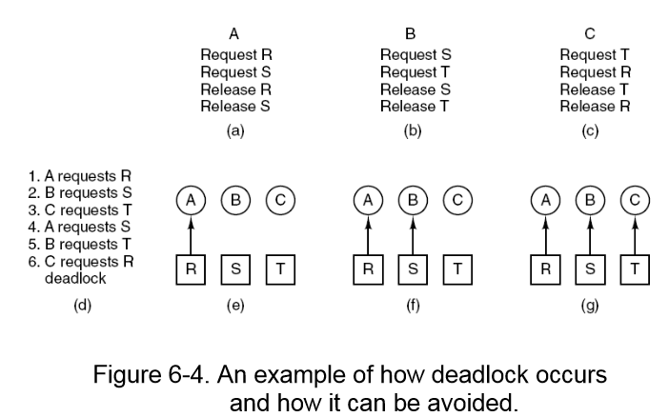
Deadlock Modeling 2

Slide 9
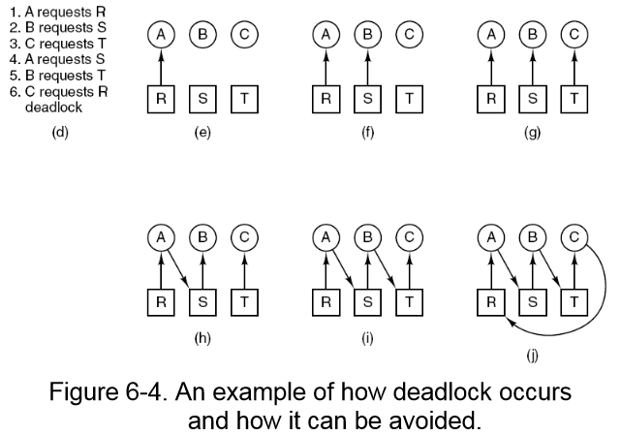
Deadlock 3

Slide 10
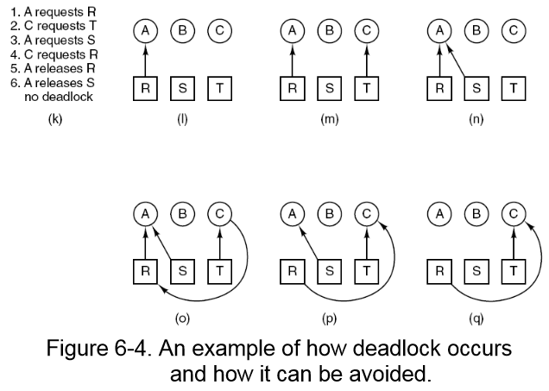
Deadlock Modeling 4

Slide 11
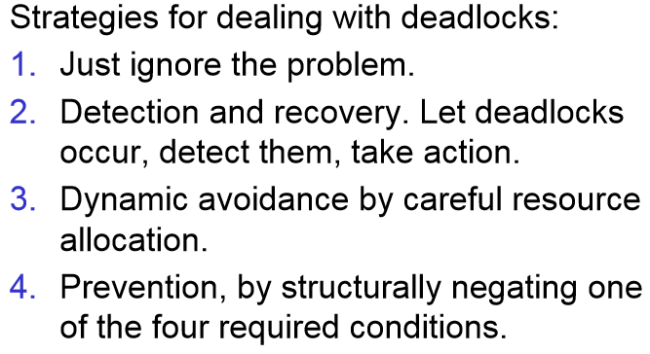
Deadlock Modeling 5

Slide 12
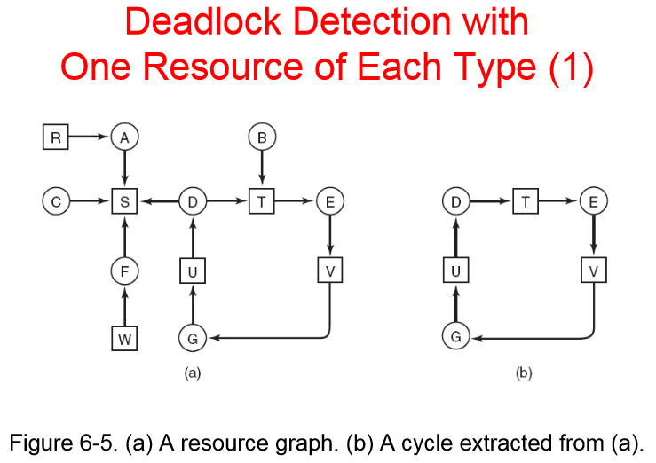

Slide 13
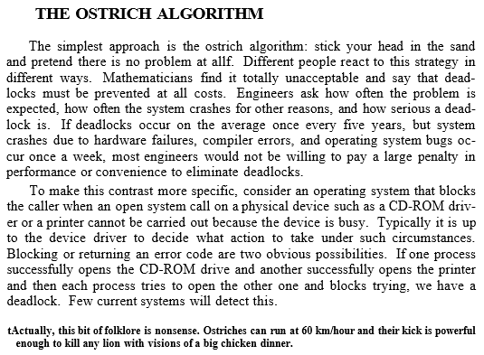

Slide 14
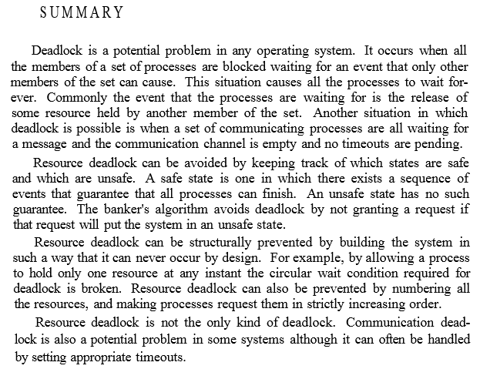

Slide 15
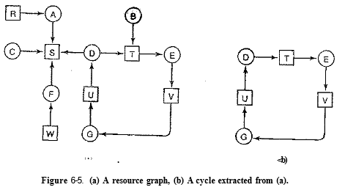
Process A holds R and wants S.
Process B holds nothing but wants T.
Process C holds nothing but wants S.
Process D holds U and wants S and T.
Process E holds T and wants V.
Process F holds W and wants S.
Process G holds V and wants U.

